Slide 1
Teaching Resources for GTAs
Dr. Andrea L. Meluch
Teaching Fellow, Institute for Teaching and Learning
Notes:
Managing Difficult Students and Student Challenges as a GTA:
Now that you are a GTA here at UA, you will likely find yourself working closely with undergraduate students on campus. We have a wonderful, diverse student body here at Akron and students are often looking to their instructors and teaching assistants for guidance, support, and membership during their time here Akron. Unfortunately, sometimes students will have a difficulty in their courses, a disagreement with their instructor or TA, or personal and academic problems that get in the way of them being successful in their courses. This short video will provide some case studies that you can use to think about and consider how to respond appropriately when faced with a student issue as a GTA.

Slide 2
Preview
ITL and OLS Overview
Principles of Effective Course Delivery
AI Challenges with Teaching Today
Managing Difficult Students as a GTA Case Studies
Developing Positive Faculty Advisor-GTA Relationships
Work-Life Balance as a GTA

Slide 3
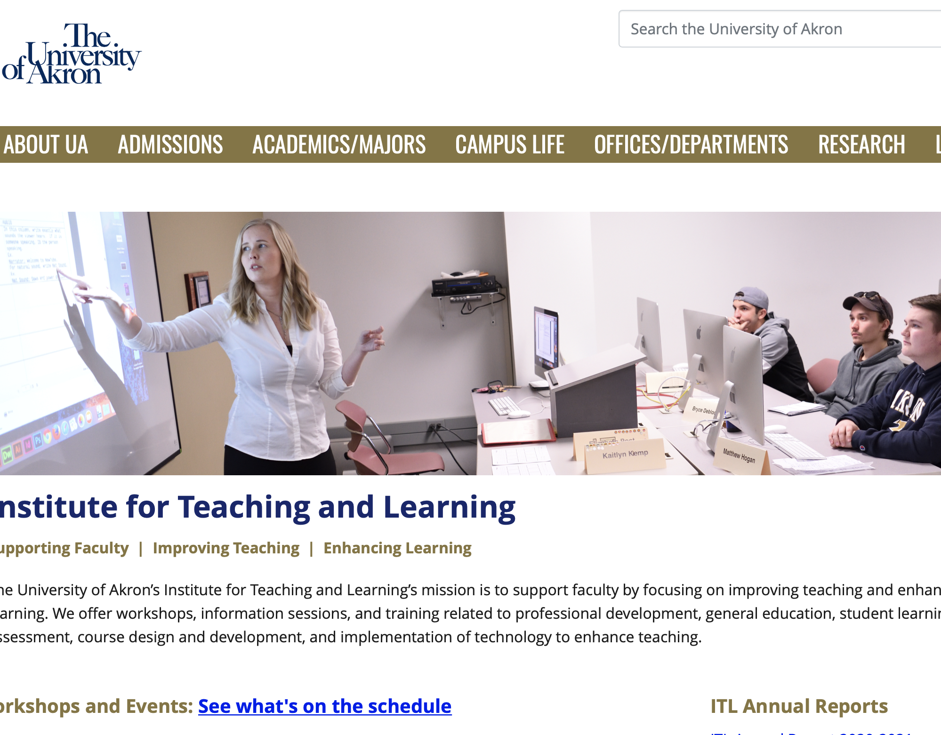
Institute for Teaching and Learning
Provides resources focused on improving teaching and enhancing student learning.
Workshops, Information Sessions, and Training
https://www.uakron.edu/itl/
ITL@uakron.edu.

Slide 4
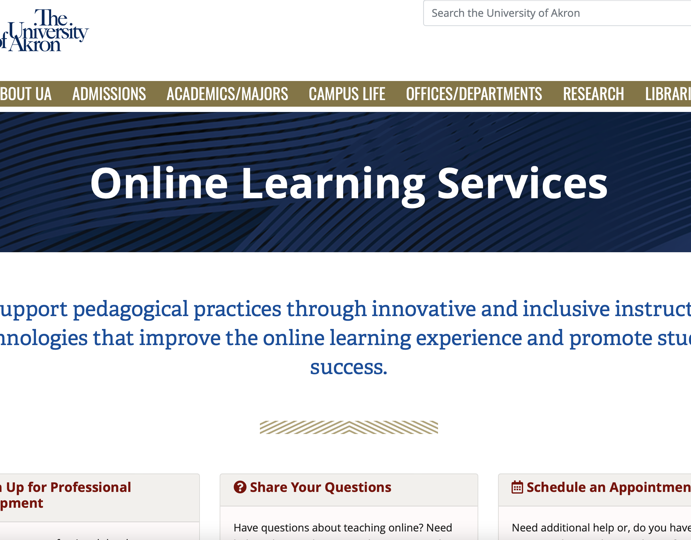
Online Learning Services
Instructional designers and multimedia experts
OLS is focused on helping all faculty (e.g., full-time, part-time, graduate teaching assistants) make the most of Brightspace
https://uakron.edu/learn/ols/index.dot
DDSHelp@uakron.edu.

Slide 5

Brightspace Training
Brightspace Level 1 Training
Most GTAs will receive Brightspace shells from their department
Important Brightspace Features for GTAs:
  Grading
  Quizzes
  Announcements

Slide 6
Principles of Effective Course Delivery

Slide 7

Be Visible and Accessible in the Classroom
First day of class introductions/ icebreakers
Keep in touch with students (e.g., announcements, emails)
Office hours

Slide 8
Use Inclusive Teaching Practices
“Pedagogy that strives to serve the needs of all students, regardless of background or identity, and support their engagement with subject material" (Yale Poorvu Center for Teaching and Learning, 2017).
Examples of Inclusive Teaching Practices:
  Make materials accessible (e.g., closed captioned)
  Use inclusive language
  Share pronouns
  Use materials from diverse voices

Slide 9

Commit to Active Instruction
Active learning techniques:
  Small group discussions
  Games/gamification
  Polling
  Think-Pair-Share

Slide 10
Provide Quality Feedback
Provide multiple opportunities for students to demonstrate learning.
Provide feedback early.
Provide students with clear instructions, rationale, and evaluation criteria.
Use rubrics.

Slide 11
AI Challenges
ChatGPT, Bard AI, Bing AI, Elicit, etc.
UA Policy
Explaining ethical and unethical uses of AI to students.
Ethical Use of AI: AI tools (such as ChatGPT) are powerful tools that can be used to aid in the learning process. Students should look to their instructors for guidance on the fair and ethical use of AI tools for this course. The inappropriate or unethical use of such technologies will violate the Code of Student Conduct as cheating, plagiarism, fabrication, unauthorized collaboration, misrepresentation, and/or gaining an unfair advantage. The Code of Student Conduct is a University rule that provides the framework for the student conduct process at the University of Akron and defines student misconduct and the process that the University will use to address student misconduct reported to the Department of Student Conduct and Community Standards. Students at the University of Akron are responsible to know and abide by the Code of Student Conduct and all University rules, regulations, and policies.

Slide 12
Managing Difficult Students and Student Challenges as a GTA

Slide 13
Case Study 1: Melissa
Melissa has been a great student for most of the semester in your College Writing course. However, over the past couple of weeks you have noticed that she is quiet in class.
You are grading the weekly reflection activity and find the following comment on Melissa’s submission:
  I am really struggling with finding the motivation to write this reflection entry this week. I honestly feel like I have nothing to say and I am not really sure if I want to even stay in school.
Notes:
Let’s start with the first case study – Melissa. In this case study, imagine that you are a teaching assistant in a college writing course. You have noticed that a once engaged student, Melissa, has started to become very quiet and reserved in class. She does not raise her hand any more and does not seem to participate much in group discussions, which is different from how she was acting just a few weeks ago. Now you come to grade the reflection activity on Brightspace and see that Melissa has left the following comment with here submission:
I am really struggling with finding the motivation to write this reflection entry this week. I honestly feel like I have nothing to say and I am not really sure if I want to even stay in school.
As a GTA, you may be wondering, “What should I do?”
Here are some tips you can use to help Melissa. First, acknowledge Melissa’s concerns, especially that many students struggle to stay motivated throughout the semester. Do not accuse her of slacking off, but instead try to understand what underlying issues may be contributing to these challenges. For example, maybe she is working a lot of hours to pay for school or maybe she is dealing with depression. Next, consider referring her to ZipAssist using the ZipAssist website. They may be able to reach out and see about connecting Melissa to on-campus resources, such as tutoring, counseling services, or an academic advisor who can work directly with Melissa to help her in her studies. Finally, let Melissa know that you are there for her as her TA. See if setting up a study schedule or weekly coaching meetings via Teams is something she would be interested in to help her get back on track in the class.

Slide 14
Case Study 2: TJ
TJ has missed multiple class meetings this semester in your lab section. His lab reports have also gotten low grades consistently.
It is week 11 in the semester, and you receive the following email from TJ:
  Hi TA Smith: I was looking at my Brightspace grades today and I’m not sure why I have such a low grade. I know I missed a couple of classes, but those were for athletics reasons. I really need to pass this class and I think that you can give me some additional points on my lab reports. -TJ
Notes:
In our second case study, we have TJ enrolled in a lab section that you are serving as the TA for this semester. Students are required to attend every lab session, but TJ has missed several classes. While a couple of the absences were sports-related, he has missed other classes without a documented excuse. When he has submitted his lab report assignments on Brightspace they have not included all of the required information. It is now Week 11 and TJ has a 57.89% in the class and you receive the following email from TJ:
Hi TA Smith: I was looking at my Brightspace grades today and I’m not sure why I have such a low grade. I know I missed a couple of classes, but those were for athletics reasons. I really need to pass this class and I think that you can give me some additional points on my lab reports. -TJ
This situation is unfortunately one that you might encounter. Some ways to handle the situation include, scheduling a face-to-face meeting with the student to discuss the expectations of the course, where he has missed points on previous assignments, and what he can do in the final few weeks to turn his grade around. Be careful to not to respond defensively via email and escalate the conflict. Instead be open and listen to the student’s side of the story. If the student becomes frustrated or becomes verbally aggressive in the exchange, stay calm and provide the student with the contact information for the faculty member who coordinates the course and document the student’s conduct and report it to your supervisor.

Slide 15
Case Study 3: Allison
Allison is enrolled in your Introduction to Psychology course and has been a good student this semester.
This week students had to write a 3-page case analysis paper. When grading Allison’s paper you noticed that some of the content seemed off. You did a quick search and found that nearly half of the paper was plagiarized.
Notes:
In our final case study, we will consider what to do if a student plagiarizes in a course you are the instructor or TA in. In this case Allison submits a paper that includes almost 50% of plagiarized content. You may be struggling with knowing what is the right thing to do in this case since Allison has been a good student in the course up until now.
First, discuss the case with your supervisor so they are aware that you are dealing with a plagiarism case in one of your classes. As a GTA, you will want your supervisor to know about this and see if they want to intervene or if they would like you to work with the student. If you are asked to address the matter with the student you will want to schedule a meeting with Allison to discuss the plagiarism in her paper. Point out how the content was plagiarized, whether it was missing quotation marks because the content was copy-and-pasted from another source or did not attribute paraphrased content to the original source. Further, explain to Allison how plagiarism is against the rules in the University of Akron Student Code of Conduct and can result in failure of an assignment, course, or further actions. Allow Allison the opportunity to explain how she made the mistake and provide her with resources on how to make sure she does not make the mistake again in the future including the Purdue OWL website and the Writing Center on campus. Finally, make a decision about how to handle the student grade. It may make sense to give Allison a zero for this assignment, however, if there were extenuating circumstances, such as maybe she did not realize she plagiarized, you may want to give her a second chance to make up the assignment correctly. With all plagiarism cases you will need to complete the academic misconduct notification form that you can find on the Academic Misconduct Referral Process webpage which is linked in this Brightspace module. If you cannot resolve the plagiarism issue informally, you may need to refer to the case to Department of Student Conduct and Community Standards for adjudication.

Slide 16
Key Takeaways
Be understanding.
Provide resources.
Be firm.
Reach out to supervisors and campus administrators for support.
Notes:
As a GTA it can be especially hard to know where to turn when you encounter student issues or challenging students. Remember to first be understanding and empathetic towards students. Many undergraduate students will make mistakes and will learn valuable lessons from these mistakes. Give them the opportunity to be accountable for these issues and provide them with the resources they need to be successful in the future. Next, do not be afraid to be firm and stick to your policies. If a student questions a policy or believes they are an exception, it is okay to hear them out but know that you need to use the same set of policies for all students in the class to be fair and objective. Finally, when there is a concern or challenge with a student, reach out to your advisor or supervisor or the office of student conduct for support. These senior faculty members and administrators have a lot of experience with challenging students and can step in to help manage the situation if needed.

Slide 17

Developing Positive
Faculty Advisor-GTA Relationships
Make expectations clear
Keep lines of communication open
Be reliable
Be accountable
There may be bumps in the road

Slide 18

Work-Life Balance as a GTA
Build a support system
Find the right balance of work-family-play
Practice mindfulness
Reach out for help when needed
Celebrate accomplishments – big and small

Slide 19
Questions?
Thank you!
alm133@uakron.edu

